Slide 1
FortiGate Security
Introduction and Initial Configuration
FortiOS 7.2
Notes:
In this lesson, you will learn about FortiGate administration basics and the components within FortiGate that you can enable to extend functionality. This lesson also includes details about how and where FortiGate fits into your existing network architecture.

Slide 2
High-Level Features
Setup Decisions
Basic Administration
Fundamental Maintenance
Notes:
In this lesson, you will explore the topics shown on this slide.

Slide 3
High-Level Features
Identify the platform design features of FortiGate
Identify features of FortiGate in virtualized networks and the cloud
Understand FortiGate security processing units (SPU)
Notes:
After completing this section, you should be able to achieve the objectives shown on this slide.
By demonstrating competence in identifying the platform design features of FortiGate, FortiGate features in virtualized networks and the cloud, as well as the FortiGate security processing units, you will be able to describe the fundamental components of FortiGate and explain the types of tasks that FortiGate can perform.

Slide 4
The Modern Context of Network Security
Firewalls are more than gatekeepers on the network perimeter
Today’s firewalls are designed in response to multifaceted and multidevice environments with no identifiable perimeter:
  Mobile workforce
  Partners accessing your network services
  Public and private clouds
  Internet of things (IoT)
  Bring your own device (BYOD)
Firewalls are expected to perform different functions within a network
  Different deployment modes:
    Distributed enterprise firewall
    Next-generation firewall
    Internal segmentation firewall
    Data center firewall
  DNS, DHCP, web filter, intrusion prevention system (IPS), and so on
Notes:
In the past, the common way of protecting a network was securing the perimeter and installing a firewall at the entry point. Network administrators used to trust everything and everyone inside the perimeter.
Now, malware can easily bypass any entry-point firewall and get inside the network. This could happen through an infected USB stick, or an employee’s compromised personal device being connected to the corporate network. Additionally, because attacks can come from inside the network, network administrators can no longer inherently trust internal users and devices.
What’s more, today’s networks are highly complex environments whose borders are constantly changing. Networks run vertically from the LAN to the internet, and horizontally from the physical network to a private virtual network and to the cloud. A mobile and diverse workforce (employees, partners, and customers) accessing network resources, public and private clouds, the IoT, and BYOD programs all conspire to increase the number of attack vectors against your network.
In response to this highly complex environment, firewalls have become robust multifunctional devices that counter an array of threats to your network. Thus, FortiGate can act in different modes or roles to address different requirements. For example, FortiGate can be deployed as a data center firewall whose function is to monitor inbound requests to servers and to protect them without increasing latency for the requester. Or, FortiGate can be deployed as an internal segmentation firewall as a means to contain a network breach.
FortiGate can also function as DNS and DHCP servers, and be configured to provide web filter, antivirus, and IPS services.

Slide 5
Platform Design
FortiGuard Subscription Services
• Threat intelligence • Centralized management
FortiClient
Next gen.
firewall
Antivirus
Web
filter
IPS
…
FortiWeb
FortiSandbox
FortiMail
FortiOS
Security Processing Units (SPUs)
Integration
Notes:
In the architecture diagram shown on this slide, you can see how FortiGate platforms add strength, without compromising flexibility. Like separate, dedicated security devices, FortiGate is still internally modular. Plus:
Devices add duplication. Sometimes, dedication doesn’t mean efficiency. If it’s overloaded, can one device borrow free RAM from nine others? Do you want to configure policies, logging, and routing on 10 separate devices? Does 10 times the duplication bring you 10 times the benefit, or is it a hassle? For smaller to midsize businesses or enterprise branch offices, unified threat management (UTM) is often a superior solution, compared to separate dedicated appliances.
FortiGate hardware isn’t just off-the-shelf. It’s carrier-grade. Most FortiGate models have one or more specialized circuits, called ASICs, that are engineered by Fortinet. For example, a CP or NP chip handles cryptography and packet forwarding more efficiently. Compared to a single-purpose device with only a CPU, FortiGate can have dramatically better performance. This is especially critical for data centers and carriers where throughput is business critical.
(The exception? Virtualization platforms—VMware, Citrix Xen, Microsoft, or Oracle Virtual Box—have general-purpose vCPUs. But, virtualization might be worthwhile because of other benefits, such as distributed computing and cloud-based security.)
FortiGate is flexible. If all you need is fast firewalling and antivirus, FortiGate won’t require you to waste CPU, RAM, and electricity on other features. In each firewall policy, you can enable or disable UTM and next-generation firewall modules. Also, you won’t pay more to add VPN seat licenses later.
FortiGate cooperates. A preference for open standards instead of proprietary protocols means less vendor lock-in and more choice for system integrators. And, as your network grows, FortiGate can leverage other Fortinet products, such as FortiSandbox and FortiWeb, to distribute processing for deeper security and optimal performance—a total Security Fabric approach.

Slide 6
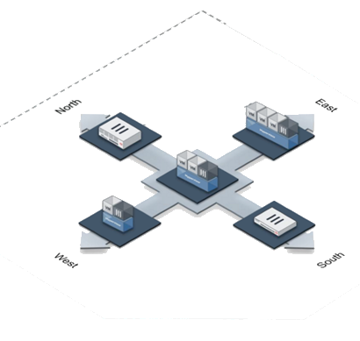
Topology in the Cloud
Deploy FortiGate in virtualized networks
  FortiGate VM – Same features as physical appliance except SPUs
VMs or physical appliances
  Configuration is essentially the same
FortiGate VM Specifications
Licenses | Max. 1 / 2 / 4 / 8 vCPU
Hypervisor | VMware, Hyper-V, KVM, Citrix Xen Server, Open Source Xen, Azure, Amazon AWS BYOL & on‑demand
Memory | Max. 1/4/8/12 GB
10/100/1000 Interfaces | 2-4 virtual NICs
Storage Capacity | 40+ GB
FortiGate Physical deployment
FortiGate VMX or VM
Notes:
FortiGate VMs have the same features as physical FortiGate devices, except for hardware acceleration. Why? First, the hardware abstraction layer software for hypervisors is made by VMware, Xen, and other hypervisor manufacturers, not by Fortinet. Those other manufacturers don’t make the Fortinet proprietary SPU chips. But there is another reason, too. The purpose of generic virtual CPUs and other virtual chips for hypervisors is to abstract the hardware details. That way, all VM guest OSs can run on a common platform, no matter the different hardware on which the hypervisors are installed. Unlike vCPUs or vGPUs that use generic, non-optimal RAM and vCPUs for abstraction, SPU chips are specialized optimized circuits. Therefore, a virtualized ASIC chip would not have the same performance benefits as a physical SPU chip.
If performance on equivalent hardware is less, you may wonder why anyone would use a FortiGate VM. In large-scale networks that change rapidly and may have many tenants, equivalent processing power and distribution may be achievable using larger amounts of cheaper, general purpose hardware. Also, trading some performance for other benefits may be worth it. You can benefit from faster network and appliance deployment and teardown.
Either VMs or physical appliances (low or high-end models), the configuration of the security instances is essentially identical, using same FortiOS version and FortiGuard real-time threat intelligence.

Slide 7


Which is a more accurate description of a modern firewall?
  A device that inspects network traffic at an entry point to the internet and within a simple, easily defined network perimeter
  A multifunctional device that inspects network traffic from the perimeter or internally, within a network that has many different entry points
Which solution specific to Fortinet enhances performance and reduces latency for specific features and traffic?
  Acceleration hardware, called SPUs
  Increased RAM and CPU power

Slide 8
High-Level Features
Setup Decisions
Basic Administration
Fundamental Maintenance
Notes:
Good job! You now understand some of the high-level features of FortiGate.
Now, you will learn how to perform the initial setup of FortiGate and learn about why you might decide to use one configuration over another.

Slide 9
Setup Decisions
Identify the factory default settings
Understand the FortiGate relationship with FortiGuard and distinguish between live queries and package updates
Notes:
After completing this section, you should be able to achieve the objectives shown on this slide.
By demonstrating competence in setting up FortiGate, you will be able to use the device effectively in your own network.

Slide 10
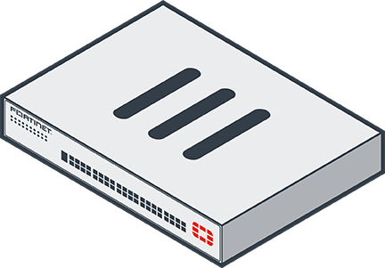


Factory Default Settings
IP: 192.168.1.99/24
  MGMT interface on high-end and mid-range models
  Port1 or internal interface on entry-level models
PING, HTTPS, and SSH protocol management enabled
Built-in DHCP server is enabled on port1 or internal interface
  Only on entry-level models that support DHCP server
Default login:
  User: admin
  Password: (blank)
  Both are case sensitive
  Modify the default (blank)
  password
Can access FortiGate on the CLI
  Console: without network
  CLI console widget and terminal emulator, such as PuTTY or Tera Term
Notes:
Network address translation (NAT) mode is the default operation mode. What are the other factory default settings? After you’ve removed FortiGate from its box, what do you do next?
Now you’ll take a look at how you set up FortiGate.
Attach your computer network cable to port1 or the internal switch ports (on the entry-level model). For high-end and mid-range models, connect to the MGMT interface. In most entry-level models, there is a DHCP server on that interface, so, if your computer’s network settings have DHCP enabled, your computer should automatically get an IP, and you can begin setup.
To access the GUI on FortiGate or FortiWifi, open a web browser and visit https://192.168.1.99.
The default login information is public knowledge. Never leave the default password blank. Your network is only as secure as your FortiGate admin account. Once you logged in with default login details, you'll see a message to change the default blank password for the admin user password. Before you connect FortiGate to your network, you should set a complex password. You’ll also be asked to apply additional configuration such as hostname, dashboard setup, register with FortiCare, and so on.
All FortiGate models have a console port and/or USB management port. The port provides CLI access without a network. You can access the CLI using the CLI console widget on the GUI, or from a terminal emulator, such as PuTTY or Tera Term.

Slide 11



FortiGuard Subscription Services
Internet connection and contract required
Provided by FortiGuard Distribution Network (FDN)
  Major data centers in North America, Asia, and Europe
    Or, from FDN through your FortiManager
  FortiGate prefers the data center in nearest time zone,
  but will adjust by server load
Package updates: FortiGuard antivirus and IPS
  update.fortiguard.net
  TCP port 443 (SSL)
Live queries: FortiGuard web filtering, DNS filtering, and antispam
  service.fortiguard.net for proprietary protocol on UDP port 53 or 8888
  securewf.fortiguard.net for HTTPS over port 443, 53 or, 8888
FortiOS uses FortiGuard server for DNS request
  By default, uses DNS over TLS (DoT) to secure dns traffic
Notes:
Some FortiGate services connect to other servers, such as FortiGuard, in order to work. FortiGuard Subscription Services provide FortiGate with up-to-date threat intelligence. FortiGate uses FortiGuard by:
Periodically requesting packages that contain a new engine and signatures
Querying the FDN on an individual URL or host name
By default, the FortiGuard server location is set to anywhere FortiGate selects a server based on server load, from any part of the world. However, you have the option to change the FortiGuard server location to USA. In this case, FortiGate selects a USA-based FortiGuard server.
Queries are real-time; that is, FortiGate asks the FDN every time it scans for spam or filtered websites. FortiGate queries, instead of downloading the database, because of the size and frequency of changes that occur to the database. Also, you can select queries to use UDP or HTTPs for transport; the protocols are not designed for fault tolerance, but for speed. So, queries require that your FortiGate device has a reliable internet connection.
Packages, like antivirus and IPS, are smaller and don't change as frequently, so they are downloaded (in many cases) only once a day. They are downloaded using TCP for reliable transport. After the database is downloaded, their associated FortiGate features continue to function, even if FortiGate does not have reliable internet connectivity. However, you should still try to avoid interruptions during downloads—if your FortiGate device must try repeatedly to download updates, it can’t detect new threats during that time.
When using FortiGuard servers for DNS, FortiOS uses DNS over TLS (DoT) by default to secure the DNS traffic. New FortiGuard DNS servers have been added as primary and secondary servers.

Slide 12
FortiGuard Subscription Services (Contd)
FortiGuard third party SSL certificate verification and OCSP stapling check
  Default FortiGuard access mode is anycast
  Optimize the routing performance to the FortiGuard servers
  FortiGate gets a single IP address for the domain name of each FortiGuard service
  FortiGuard servers query the CA OCSP responder every four hours
  Enforce a connection to use protocol HTTPS and port 443
Server | Domain name and IP address
Object download | globalupdate.fortinet.net - 173.243.140.6
Querying service (webfiltering, antispam) | globalguardservice.fortinet.net - 173.243.140.16
FortiGate Cloud logging | globallogctrl.fortinet.net - 173.243.132.25
FortiGate Cloud management | globalmgrctrl.fortinet.net - 173.243.132.26
FortiGate Cloud messaging | globalmsgctrl.fortinet.net - 173.243.132.27
FortiGate Cloud sandbox | globalaptctrl.fortinet.net - 184.94.112.22
The productapi used by OCVPN registration and GUI icon download | globalproductapi.fortinet.net - 66.35.17.252
Notes:
Now, third-party SSL certificate verification and OCSP stapling check has been implemented for all FortiGuard servers. By default, the FortiGuard access mode is anycast on FortiGate, to optimize the routing performance to the FortiGuard servers. The FortiGuard server has one IP address to match its domain name. FortiGate connects with a single server address, regardless of where the FortiGate device is located.
The domain name of each FortiGuard service is the common name in the certificate of that service. The certificate is signed by a third-party intermediate CA. The FortiGuard server uses the Online Certificate Status Protocol (OCSP) stapling technique, so that FortiGate can always validate the FortiGuard server certificate efficiently. FortiGate will complete the TLS handshake only with a FortiGuard server that provides a good OCSP status for its certificate. Any other status results in a failed SSL connection.
The FortiGuard servers query the OCSP responder of the CA every four hours and update its OCSP status. If FortiGuard is unable to reach the OCSP responder, it keeps the last known OCSP status for seven days.
FortiGate aborts the connection to the FortiGuard server if:
The CN in the server certificate does not match the domain name resolved from the DNS.
The OCSP status is not good.
The issuer-CA is revoked by the root-CA.
The FortiGuard access mode anycast setting forces the rating process to use protocol HTTPS, and port 443. The table on this slide shows a list of some of the FortiGuard servers and their domain names and IP addresses.

Slide 13

Which protocol does FortiGate use to download antivirus and IPS packages?
  UDP
  TCP
How does FortiGate check content for spam or malicious websites?
  Live queries to FortiGuard over UDP or HTTPS
  Local verification using a downloaded web filter database locally on FortiGate

Slide 14
High-Level Features
Setup Decisions
Basic Administration
Fundamental Maintenance
Notes:
Good job! You now understand how to perform the initial setup of FortiGate and why you might decide to use one configuration over another. Now, you will learn about basic administration.

Slide 15
Basic Administration
Manage administrator profiles
Manage administrative users
Define the configuration method for administrative users
Define and describe VDOMs
Control administrative access to the FortiGate GUI and CLI
Manage specific aspects of the network interfaces
Describe VLANs and VLAN tagging
Enable the DHCP and DNS services on FortiGate
Notes:
After completing this lesson, you should be able to achieve the objectives shown on this slide.
By demonstrating competence in basic administration, you will be able to better manage administrative users and implement stronger security practices around administrative access.

Slide 16
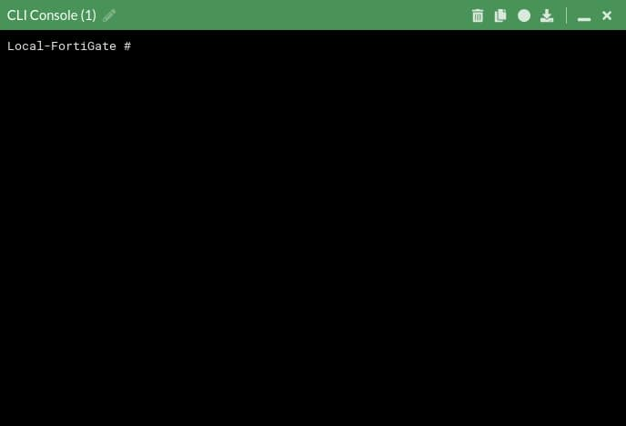


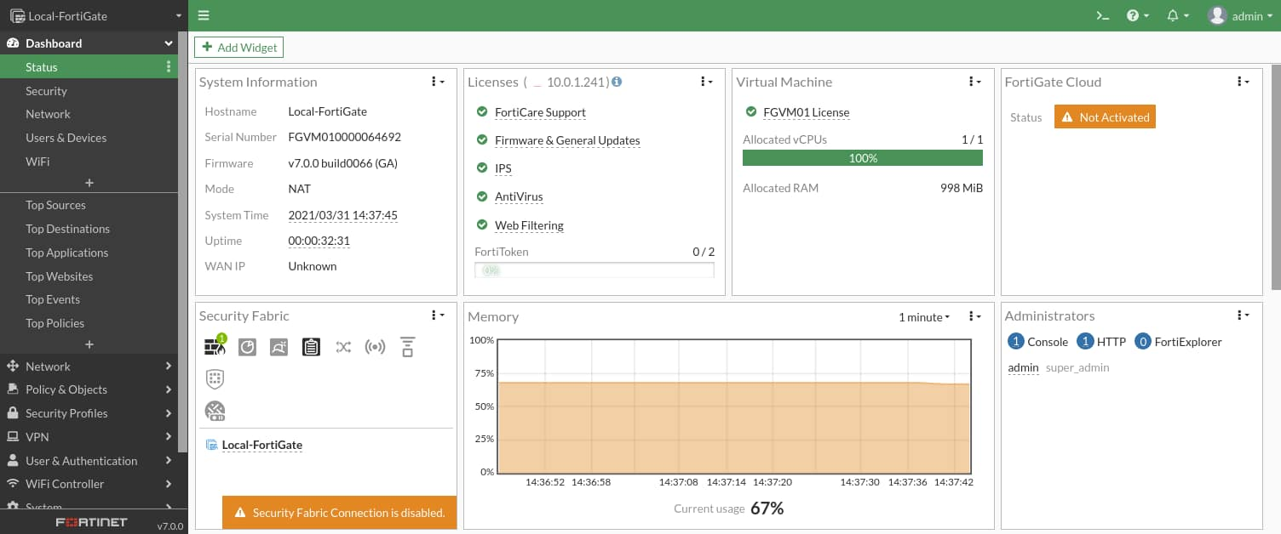
Administration Methods
CLI
Console, SSH, Telnet, GUI Widget
GUI
FortiExplorer, Web Browser (HTTP, HTTPS)
Notes:
Most features are available on both the GUI and CLI, but there are a few exceptions. You can't view reports on the CLI. Also, advanced settings and diagnostic commands for super users are usually not available on the GUI.
As you become more familiar with FortiGate, and especially if you want to script its configuration, you might want to use the CLI in addition to the GUI. You can access the CLI through either the JavaScript widget on the GUI named CLI Console, or through a terminal emulator such as Tera Term (http://ttssh2.sourceforge.jp/index.html.en) or PuTTY (http://www.chiark.greenend.org.uk/~sgtatham/putty/download.html). Your terminal emulator can connect through the network—SSH or telnet—or the local console port.
SNMP and some other administrative protocols are also supported, but they are read-only. You can't use them for basic setup.

Slide 17
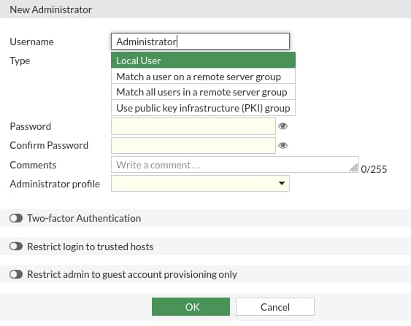
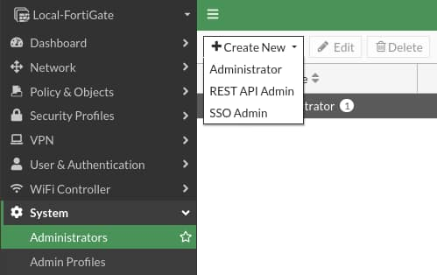
Create an Administrative User
System > Administrators
Notes:
Whichever method you use, start by logging in as admin. Begin by creating separate accounts for other administrators. For security and tracking purposes, it is a best practice for each administrator to have their own account.
In the Create New drop-down list, you can select either Administrator or REST API Admin. Typically, you will select Administrator and then assign an Administrator Profile, which specifies that user’s administrative permissions. You could select REST API Admin to add an administrative user who would use a custom application to access FortiGate with a REST API. The application would allow you to log in to FortiGate and perform any task that your assigned Administrator Profile permits.
Other options not shown here, include:
Instead of creating accounts on FortiGate itself, you could configure FortiGate to query a remote authentication server.
In place of passwords, your administrators could authenticate using digital certificates that are issued by your internal certification authority server.
If you do use passwords, ensure that they are strong and complex. For example, you could use multiple interleaved words with varying capitalization, and randomly insert numbers and punctuation. Do not use short passwords, or passwords that contain names, dates, or words that exist in any dictionary. These are susceptible to brute force attack. To audit the strength of your passwords, use tools such as L0phtcrack (http://www.l0phtcrack.com/) or John the Ripper (http://www.openwall.com/john/). Risk of a brute force attack is increased if you connect the management port to the internet.
In order to restrict access to specific features, you can assign permissions.

Slide 18

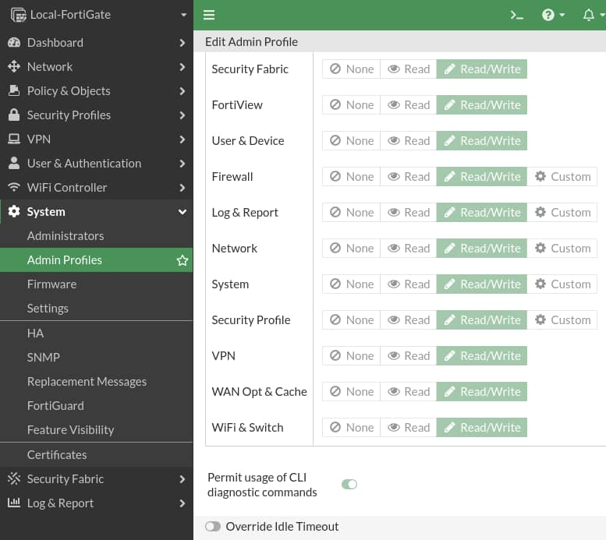
Administrator Profiles
Permissions
Hierarchy
System > Admin Profiles
super_admin
custom_profile1
prof_admin
Full global access
Partial global access
Full access in virtual domain
Partial access in VDOM
custom_profile2
Notes:
When assigning permissions to an administrator profile, you can specify read-and-write, read-only, or none to each area.
By default, there is a special profile named super_admin, which is used by the account named admin. You can't change it. It provides full access to everything, making the admin account similar to a root superuser account.The prof_admin is another default profile. It also provides full access, but unlike super_admin, it applies only to its virtual domain—not the global settings of FortiGate. Also, you can change its permissions.
You aren’t required to use a default profile. You could, for example, create a profile named auditor_access with read-only permissions. Restricting a person’s permissions to those necessary for his or her job is a best practice, because even if that account is compromised, the compromise to your FortiGate device (or network) is not total. To do this, create administrator profiles, then select the appropriate profile when configuring an account.
The Override Idle Timeout feature allows the admintimeout value, under config system accprofile, to be overridden per access profile. You can configure administrator profiles to increase inactivity timeout and facilitate use of the GUI for central monitoring. Note that you can do this on a per-profile basis, to prevent the option from being unintentionally set globally. So, what are the effects of administrator profiles?
It’s actually more than just read or write access. Depending on the type of administrator profile that you assign, an administrator may not be able to access the entire FortiGate device. For example, you could configure an account that can view only log messages. Administrators may not be able to access global settings outside their assigned virtual domain either. Virtual domains (VDOMs) are a way of subdividing the resources and configurations on a single FortiGate. Administrators with a smaller scope of permissions cannot create, or even view, accounts with more permissions.

Slide 19
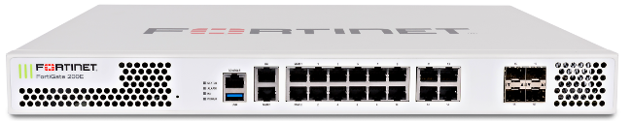
VDOMs
Global System
VDOMs split FortiGate into multiple virtual devices
  They employ independent security policies, routing tables, and so on
Packets are confined to same VDOM
By default, FortiGate supports up to 10 VDOMs
  High-end models allow for the purchase of additional VDOMs
VDOM 1
VDOM 2
VDOM 3
One security domain
Multiple security domains
Notes:
What if, more than segmenting your network, you want to subdivide policies and administrators into multiple security domains?
In that case, you can enable FortiGate VDOMs, which split your FortiGate into multiple logical devices. Each VDOM has independent security policies and routing tables. Also, and by default, traffic from one VDOM cannot go to a different VDOM. This means that two interfaces in different VDOMs can share the same IP address, without any overlapping subnet problems.
When you use VDOMs, a single FortiGate device becomes a virtual data center of network security, UTM inspection, and secure communication devices.

Slide 20
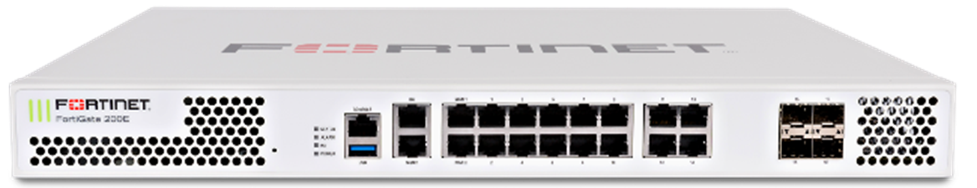
VDOM Administration
Only the account named admin or accounts with the super_admin profile can configure and back up all VDOMs
super_admin access profile
VDOM A
VDOM B
VDOM C
Global System
Notes:
If you want to grant access to all VDOMs and global settings, select super_admin as the access profile when configuring the administrator account. Similar to the account named admin, this account can configure all VDOMs.

Slide 21


Per-VDOM Administration
Other administrators can access only their assigned VDOMs
  Cannot access the global settings
Domain A
Domain B
Domain C
Notes:
In most cases, you start by creating one administrator account per VDOM. That administrator is chiefly responsible for that domain, including the configuration backups of that VDOM. In larger organizations, you may need to make multiple VDOM administrators. You can assign multiple administrators to each VDOM. You can subdivide permissions using access profiles, in order to follow best practices for segregation of duties.
The converse is also possible. If required, you can assign an administrator to multiple VDOMs.

Slide 22
Resetting a Lost Admin Password
User: maintainer
Password: bcpb<serial-number>
All letters in <serial-number> must be upper case, for example, FGT60
All FortiGate appliance models and some other Fortinet device types
No maintainer procedure in VM, revert to snapshot or reprovision VM
Only after hard power cycle
  Soft cycle (reboot) does not work for security reasons
Only during first 60 seconds after boot (varies by model)
  Tip: Copy serial number into the terminal buffer, then paste
Only through hardware console port
  Requires physical access for security reasons
  If compliance/risk of physical access requires, you can disable maintainer
      config sys global
      set admin-maintainer disable
      end
Notes:
What happens if you forget the password for your admin account, or a malicious employee changes it?
This recovery method is available on all FortiGate devices and even some non-FortiGate devices, like FortiMail. There is no maintainer procedure in the VM. The administrator must revert to a snapshot or reprovision the VM and restore the configuration. It’s a temporary account, only available through the local console port, and only after a hard reboot—disrupting power by unplugging or turning off the power, then restoring it. You must physically shut off FortiGate, then turn it back on, not reboot it through the CLI.
The maintainer login is available for login only for about 60 seconds after the restart completes (or less time on older models).
If you cannot ensure physical security, or have compliance requirements, you can disable the maintainer account. Use caution if you disable maintainer and then lose your admin password, because you cannot recover access to your FortiGate device. In order to regain access in this scenario, you will need to reload the device. This will reset to the device to its factory default settings.

Slide 23
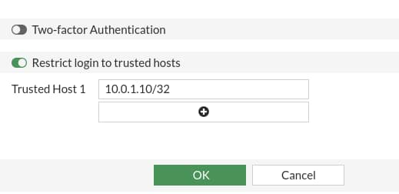
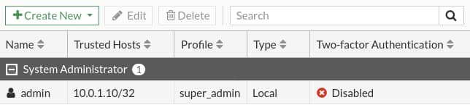
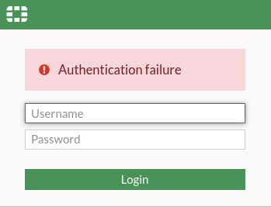
Administrative Access―Trusted Sources
System > Administrators
If admin attempts to log in to the FortiGate GUI from any IP other than 10.0.1.10, they receive this message
Notes:
Another way to secure FortiGate is to define the hosts or subnets that are trusted sources from which to log in.
In this example, we have configured 10.0.1.10 as the only trusted IP for admin from which admin logs in. If admin attempts to log in from a machine with any other IP, they will receive an authentication failure message.
Note that If trusted hosts are configured on all administrators and an administrator is trying to log in from an IP address that is not set on any of the trusted hosts for any administrators, then the administrator will not get the login page but rather will receive the message: “Unable to contact server”.
If you leave any IPv4 address as 0.0.0.0/0, it means that connections from any source IP will be allowed. By default, 0.0.0.0/0 is the configuration for the administrator, although you may want to change this.
Notice that each account can define its management host or subnet differently. This is especially useful if you are setting up VDOMs on FortiGate, where the VDOM administrators may not even belong to the same organization. Be aware of any NAT that occurs between the desired device and FortiGate. You can easily prevent an administrator from logging in from the desired IP address if it is later NATed to another address before reaching FortiGate, thus defeating the purpose of the trusted hosts.

Slide 24
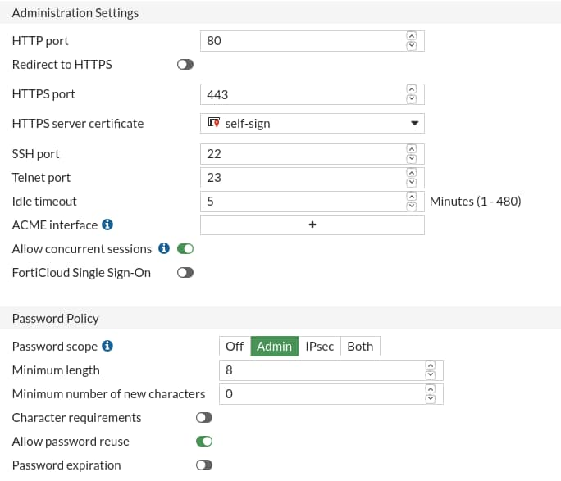
Administrative Access―Ports and Password
System > Settings
Port numbers are customizable
Using only secure access (SSH, HTTPS) is recommended
Default Idle timeout is five minutes
Notes:
You may also want to customize the administrative protocols port numbers.
You can choose whether to allow concurrent sessions. You can use concurrent sessions to avoid accidentally overwriting settings, if you usually keep multiple browser tabs open, or accidentally leave a CLI session open without saving the settings, then begin a GUI session and accidentally edit the same settings differently.
For better security, use only secure protocols, and enforce password complexity and changes.
The Idle timeout settings specifies the number of minutes before an inactive administrator session times out (default is five minutes). A shorter idle timeout is more secure, but increasing the timer can help reduce the chance of administrators being logged out while testing changes.
You can override the idle timeout setting per administrator profile using the Override Idle Timeout setting.
You can configure an administrator profile to increase inactivity timeout and facilitate use of the GUI for central monitoring. The Override Idle Timeout setting allows the admintimeout value, under config system accprofile, to be overridden per access profile.
Note that you can do this on a per profile basis, to avoid the option from being unintentionally set globally.

Slide 25
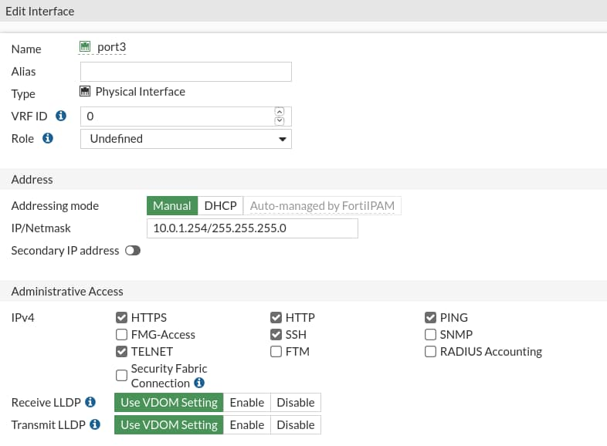
Administrative Access―Protocols
Enable acceptable management protocols on each interface independently:
  Separate IPv4 and IPv6
  IPv6 options hidden by default
Also protocols where FortiGate is the destination IP:
  Security Fabric Connection:
    CAPWAP
    FortiTelemetry
  FMG-Access
  FTM
  RADIUS Accounting
LLDP Support
  Detecting an upstream Security Fabric FortiGate through LLDP
Network > Interfaces
Notes:
You’ve defined the management subnet—that is, the trusted hosts—for each administrator account. How do you enable or disable management protocols?
This is specific to each interface. For example, if your administrators connect to FortiGate only from port3, then you should disable administrative access on all other ports. This prevents brute force attempts and also insecure access. Your management protocols are HTTPS, HTTP, PING, and SSH. By default, the HTTP and TELNET option is not visible on the GUI.
Consider the location of the interface on your network. Enabling PING on an internal interface is useful for troubleshooting. However, if it’s an external interface (in other words, exposed to the internet), then the PING protocol could expose FortiGate to a DoS attack. You should disable protocols that do not encrypt data flow, such as HTTP and TELNET. IPv4 and IPv6 protocols are separate. It’s possible to have both IPv4 and IPv6 addresses on an interface, but only respond to pings on IPv6.
Security Fabric connection includes CAPWAP and FortiTelemetry. Protocols like FortiTelemetry are not for administrative access, but, like GUI and CLI access, they are protocols where the packets have FortiGate as a destination IP. Use the FortiTelemetry protocol specifically for managing FortiClient and the Security Fabric. Use the CAPWAP protocol for FortiAP, FortiSwitch, and FortiExtender when they are managed by FortiGate. Use the FMG-Access protocol specifically for communicating with FortiManager when that server is managing multiple FortiGate devices. Use the RADIUS accounting protocol when FortiGate needs to listen for and process RADIUS accounting packets for single sign-on authentication. FTM, or FortiToken Mobile push, supports second-factor authentication requests from a FortiToken mobile app.
When you assign the interface roles LAN or WAN to the appropriate interfaces, your FortiGate uses the Link Layer Discovery Protocol (LLDP) to detect if there’s an upstream FortiGate in your network. If FortiGate discovers an upstream FortiGate, you're prompted to configure the upstream FortiGate device to join the Security Fabric.

Slide 26
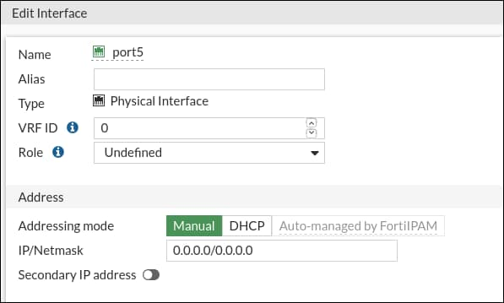
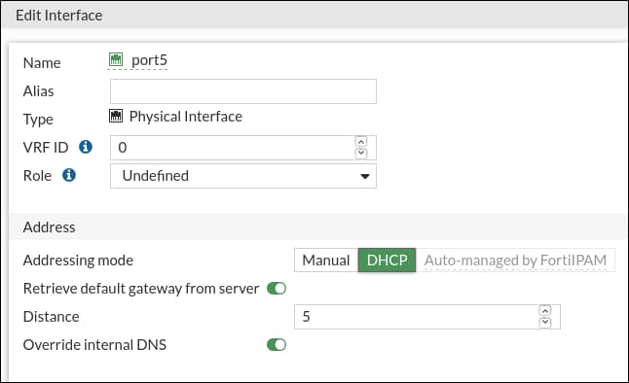
Interface IPs
In NAT mode, you can't use interfaces until they have an IP address:
  Manually assigned
  Automatic
    DHCP
    PPPoE
Network > Interfaces
Notes:
When FortiGate is operating in NAT mode, every interface that handles traffic must have an IP address. When in NAT mode, FortiGate can use the IP address to source the traffic, if it needs to start or reply to a session, and as a destination address for devices trying to contact FortiGate or route traffic through it. There are multiple ways to get an IP address:
Manually
Automatically, using either DHCP or PPPoE (available on the CLI)

Slide 27
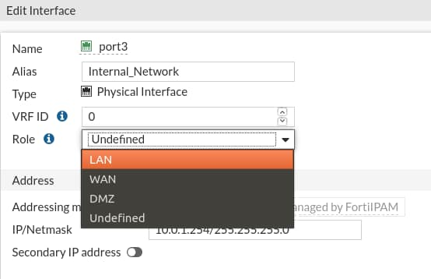
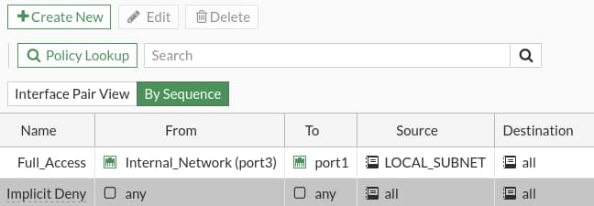
Interface Role Compared to Alias
Role defines interface settings typically grouped together:
  Prevents accidental misconfiguration
  Four types:
    WAN
    LAN
    DMZ
    Undefined (show all settings)
  Not in list of policies
Alias is a friendly descriptor for the interface:
  Used in list of policies to label
  interfaces by purpose
Network > Interfaces
Alias
Role
Policy & Objects > Firewall Policy
Notes:
How many times have you seen network issues caused by a DHCP server—not client—enabled on the WAN interface?
You can configure the interface role. The roles shown on the GUI are the usual interface settings for that part of a topology. Settings that do not apply to the current role are hidden on the GUI. (All settings are always available on the CLI regardless of the role.) This prevents accidental misconfiguration.
For example, when the role is configured as WAN, there is no DHCP server and device detection configuration available. Device detection is usually used to detect devices internally on your LAN.
If there is an unusual case, and you need to use an option that’s hidden by the current role, you can always switch the role to Undefined. This displays all options.
To help you remember the use of each interface, you can give them aliases. For example, you could call port3 internal_network. This can help to make your list of policies easier to comprehend.

Slide 28

VLANs
Logically subdivide your physical Layer 2 network into smaller segments
  Each segment forms a separate broadcast domain
  VLAN tags added to frames to identify their network segments
Physical interfaces
VLANs
Notes:
VLANs split your physical LAN into multiple, logical LANs. In NAT operation mode, each VLAN forms a separate broadcast domain. Multiple VLANs can coexist in the same physical interface, provided they have different VLAN IDs. In this way, a physical interface is split into two or more logical interfaces. A tag is added to each Ethernet frame to identify the VLAN to which it belongs.

Slide 29
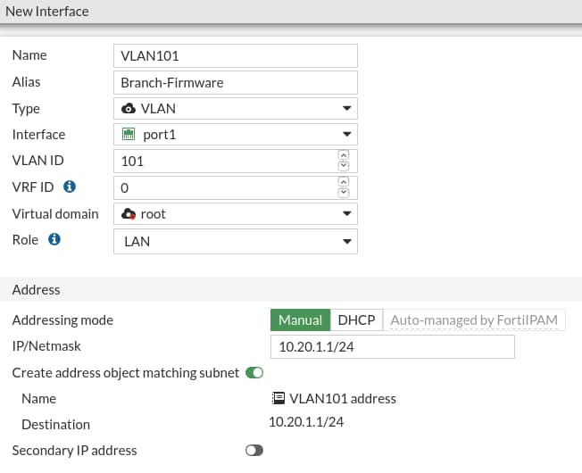
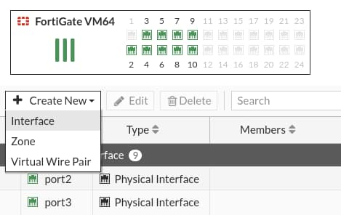
Creating VLANs
Frames sent or received by the physical interface segment are never tagged; they belong to the native VLAN
Network > Interfaces
Notes:
To create a VLAN using the GUI, click Create New, select Interface, and then, in the Type drop-down list, select VLAN. You must specify the VLAN ID and the physical interface to which the VLAN will be bound. Frames that belong to interfaces of that type are always tagged. On the other hand, frames sent or received by the physical interface segment are never tagged. They belong to what is called the native VLAN (VLAN ID 0).
Note that in a multi-VDOM environment, the physical interface and its VLAN sub-interface can be in separate VDOMs.

Slide 30
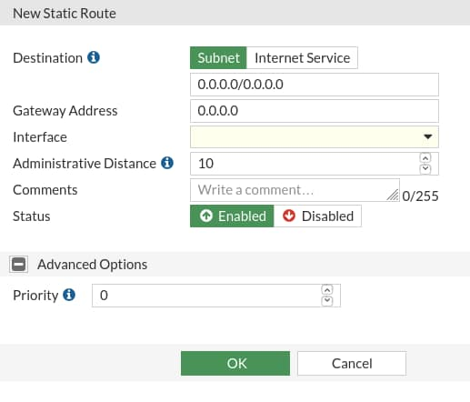
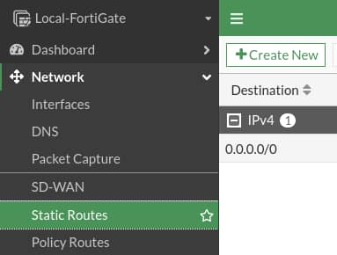
Static Gateway
Must be at least one default gateway
If the interface is DHCP or PPPoE, the gateway can be added dynamically
Network > Static Routes
Notes:
Before you integrate FortiGate into your network, you should configure a default gateway.
If FortiGate gets its IP address through a dynamic method such as DHCP or PPPoE, then it should also retrieve the default gateway.
Otherwise, you must configure a static route. Without this, FortiGate will not be able to respond to packets outside the subnets directly attached to its own interfaces. It probably also will not be able to connect to FortiGuard for updates, and may not correctly route traffic.
You should make sure that FortiGate has a route that matches all packets (destination is 0.0.0.0/0), known as a default route, and forwards them through the network interface that is connected to the internet, to the IP address of the next router.
Routing completes the basic network settings that are required before you can configure firewall policies.

Slide 31
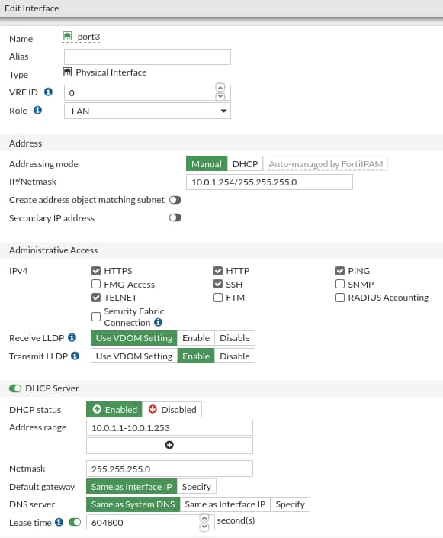
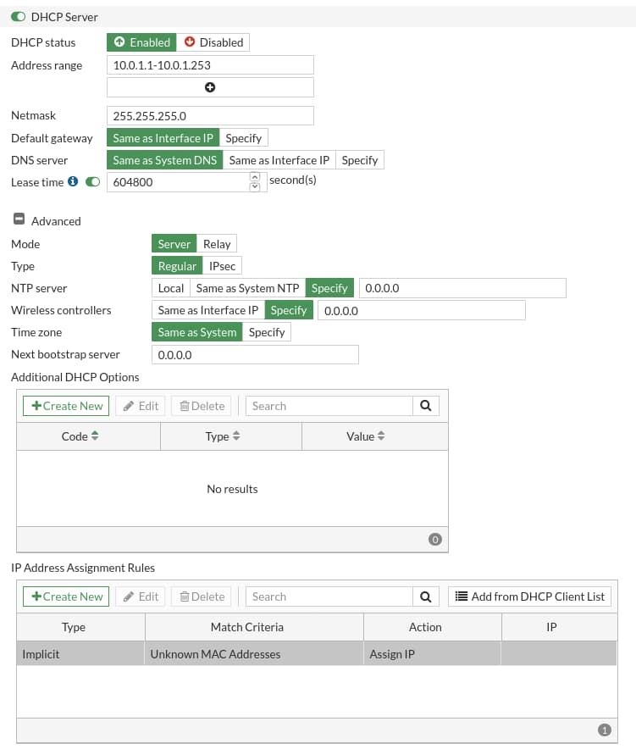
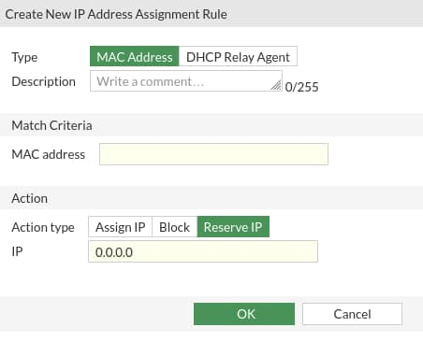
FortiGate as a DHCP Server
Network > Interfaces
Notes:
Wireless clients are not the only ones that can use FortiGate as their DHCP server.
For an interface (such as port3), select the Manual option, enter a static IP, and then enable the DHCP Server option. Options for the built-in DHCP server appear, including provisioning features, such as DHCP options and IP address assignment rules. You can also block specific MAC addresses from receiving an IP address.
Note that the screenshot on the middle of the slide shows that you can create IP address assignment rules in the IP Address Assignment Rule section. The IP Address Assignment Rule section allows you to assign, block or reserve the IP address to the host. It also allows you to select actions for unknown MAC addresses. The default action is Assign IP; however, you can change the default action type to Assign IP or Block.

Slide 32
FortiGate as a DNS Server
Resolves DNS lookups from the internal network:
  Enabled per interface
  Not appropriate for internet service because of load, and therefore should not be public facing
One DNS database can be shared by all FortiGate interfaces:
  Can be separate per VDOM
Resolution methods:
  Forward: relay requests to the next server (in DNS settings)
  Non-recursive: use FortiGate DNS database only to try to resolve queries
  Recursive: use FortiGate DNS database first; relay unresolvable queries to next server (in DNS settings)
Notes:
You can configure FortiGate to act as your local DNS server. You can enable and configure DNS separately on each interface.
A local DNS server can improve performance for your FortiMail device or other devices that use DNS queries frequently. If your FortiGate device offers DHCP to your local network, you can use DHCP to configure those hosts to use FortiGate as both the gateway and DNS server.
FortiGate can answer DNS queries in one of three ways:
Forward: relays all queries to a separate DNS server (that you have configured in Network > DNS); that is, it acts as a DNS relay instead of a DNS server.
Non-Recursive: replies to queries for items in the FortiGate DNS databases and does not forward unresolvable queries.
Recursive: replies to queries for items in the FortiGate DNS databases and forwards all other queries to a separate DNS server for resolution.
You can configure all modes on the GUI or CLI.

Slide 33
How do you restrict logins to FortiGate from only specific IP addresses?
  Change the FortiGate management interface IP address.
  Configure a trusted host.
As a best security practice when configuring administrative access to FortiGate, which protocol should you disable?
  Telnet
  SSH
When configuring FortiGate as a DNS server, which resolution method uses only the FortiGate DNS database to try to resolve queries?
  Non-recursive
  Recursive

Slide 34
High-Level Features
Setup Decisions
Basic Administration
Fundamental Maintenance
Notes:
Good job! You now have the knowledge needed to carry out some basic administrative tasks. You also know how to enable DHCP and DNS services on FortiGate.
Now, you will learn about fundamental maintenance.

Slide 35
Fundamental Maintenance
Back up and restore system configuration files
Understand the restore requirements for plaintext and encrypted configuration files
Identify the current firmware version
Upgrade firmware
Downgrade firmware
Notes:
After completing this section, you should be able to achieve the objectives shown on this slide.
By demonstrating competence in the basic maintenance of FortiGate, you will be able to perform the vital activities of backing up and restoring configurations, upgrading and downgrading firmware, and ensuring that FortiGate remains reliably in service throughout its lifecycle.

Slide 36
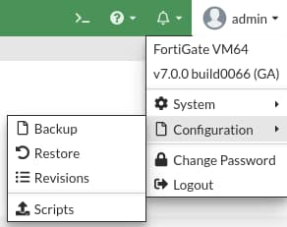
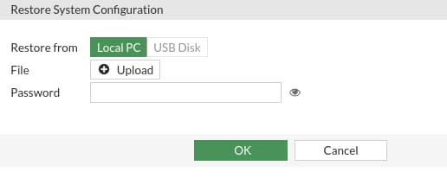
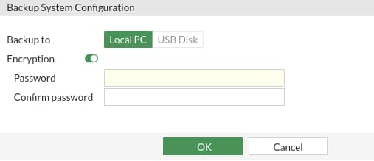
Configuration File―Backup and Restore
Configuration can be saved to an external device
  Optional encryption
  Can back up automatically
    Upon logout
    Not available on all models
To restore a previous configuration, upload file
  Reboots FortiGate
Notes:
Now that FortiGate has basic network settings and administrative accounts, you will learn how to back up the configuration. In addition to selecting the destination of the backup file, you can choose to encrypt or not to encrypt the backup file. Even if you choose not to encrypt the file, which is the default, the passwords stored in the file are hashed, and, therefore, obfuscated. The passwords that are stored in the configuration file would include passwords for the administrative users and local users, and preshared keys for your IPSec VPNs. It may also include passwords for the FSSO and LDAP servers.
The other option is to encrypt the configuration file with a password. Besides securing the privacy of your configuration, it also has some effects you may not expect. After encryption, the configuration file cannot be decrypted without the password and a FortiGate of the same model and firmware. This means that if you send an encrypted configuration file to Fortinet technical support, even if you give them the password, they cannot load your configuration until they get access to the same model of FortiGate. This can cause unnecessary delays when resolving your ticket.
If you enable virtual domains (VDOMs), subdividing the resources and configuration of your FortiGate device, each VDOM administrator can back up and restore their own configurations. You don’t have to back up the entire FortiGate configuration, however, it is still recommended.
Backups are needed to help speed up the return to production in the event of an unforeseen disaster that damages FortiGate. Having to recreate hundreds of policies and objects from scratch takes a significant amount of time, while loading a configuration file on a new device takes much less.
Restoring a configuration file is very similar to backing one up and restarts FortiGate.

Slide 37

Configuration File Format
Only non-default and important settings (smaller file size)
Header shows device model and firmware
  After the header, the encrypted file is not readable
Restoring configuration
  Encrypted? Same device/model + build + password required
  Unencrypted? Same model required
Plain text
Model
#config-version=FGVM64-7.2.0-FW-build1157-220331:opmode=0:vdom=0:user=admin
#conf_file_ver=204466213140978
#buildno=1157
#global_vdom=1
Build number
Build number
Firmware major version
Encrypted
#FGBK|3|FGVM64|7|02|1157|
Model
Firmware major version
Notes:
If you open the configuration file in a text editor, you’ll see that both encrypted and unencrypted configuration files contain a cleartext header that contains some basic information about the device. The example on this slide shows what information is included. To restore an encrypted configuration, you must upload it to a FortiGate device of the same model and firmware, then provide the password.
To restore an unencrypted configuration file, you are required to match only the FortiGate model. If the firmware is different, FortiGate will attempt to upgrade the configuration. This is similar to how it uses upgrade scripts on the existing configuration when upgrading firmware. However, it is still recommended to match the firmware on FortiGate to the firmware listed in the configuration file.
Usually, the configuration file contains only non-default settings, plus few default, yet crucial, settings. This minimizes the size of the backup, which could otherwise be several megabytes in size.

Slide 38
Configuration File Format (Contd)
Support YAML
Configuration can be backedup and restored by CLI only
  # execute backup yaml-config {ftp | tftp} <filename> server [username] [password]
  # execute restore yaml-config {ftp | tftp} <filename> server [username] [password]
YAML Format
Default Format
config_system_global:
admintimeout:480
alias:FortiGate-100F
config_system_settings:
default-voip-alg-mode: kernel-helper-based
gui-dynamic-routing: enable
config_system_interface:
- port1:
vdom: root
ip: "204.126.10.3 255.255.254.0"
allowaccess: ping
secondaryip:
- 0:
ip: "204.126.10.2 255.255.255.0"
allowaccess: ping
config system global
set admintimeout 480
set alias "FortiGate-100F"
end
config system settings
set default-voip-alg-mode kernel-helper-based
set gui-dynamic-routing enable
end
config system interface
edit "port1"
set vdom "root"
set ip 204.126.10.3 255.255.254.0
set allowaccess ping
config secondaryip
edit 1
set ip 204.126.10.2 255.255.255.0
set allowaccess ping
end
end
Notes:
YAML format becomes more and more popular often use to create configuration files. FortiOS now supports YAML format, you can take a backup as well as restore YAML configuration file using CLI commands. You must provide server type: ftp or tftp, filename, server IP address, and user credential's to backup or restore configuration file in YAML format.
This slide shows the sample configuration to understand the difference between the default file format and YAML format.

Slide 39
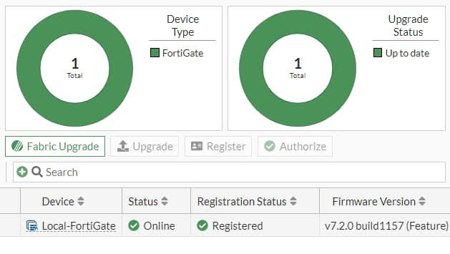
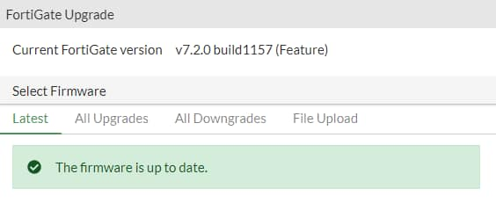
Upgrade Firmware
You can view the current firmware version on the dashboard or in System > Fabric Management (or on the CLI: get system status)
If there is an updated firmware version, you are notified
Firmware can be updated by clicking Upgrade and then selecting the All Upgrades or File Upload option
Make sure you read the Release Notes to verify the upgrade path and other details
System > Fabric Management
Notes:
You can view the current firmware version in multiple places on the FortiGate GUI. When you first log in to FortiGate, the landing page is the dashboard. You can see the firmware version in the System widget. This information is also found at System > Fabric Management. And, of course, you can retrieve the information on the CLI using the command get system status.
If a new version of the firmware is available, you are notified on the dashboard and on the Fabric Management page. The Fabric Management page allows administrators to manage the firmware running on each FortiGate, FortiAP, and FortiSwitch in the Security Fabric, and to authorize and register these Fabric devices.
You can use Upgrade option to upgrade firmware of the selected device. The Fabric Upgrade option upgrades firmware for the root FortiGate as well as Fabric devices. You can also use this option to upgrade firmware for a non-Security Fabric FortiGate with managed FortiSwitch and FortiAP devices.
The Fabric Upgrade option uses released firmware images from FortiGuard.
You can also use the Register option to register a selected device to FortiCare and an Authorize option to authorize a selected device for use in security fabric.
Remember to read the Release Notes to make sure that you understand the supported upgrade path. The Release Notes also provide pertinent information that may affect the upgrade.

Slide 40
When restoring an encrypted system configuration file, in addition to needing the FortiGate model and firmware version from the time the configuration file was produced, what must you also provide?
  The password to decrypt the file
  The private decryption key to decrypt the file
Which document should you consult to increase the chances of success before upgrading or downgrading firmware?
  Cookbook
  Release Notes

Slide 41
High-Level Features
Setup Decisions
Basic Administration
Fundamental Maintenance
Notes:
Congratulations! You have completed this lesson.
Now, you will review the objectives that you covered in the lesson.

Slide 42
Identify key FortiGate features, services, and built-in servers
Identify the relationship between FortiGate and FortiGuard
Identify the factory defaults, basic network settings, and console ports
Execute basic administration, such as creating administrative users and permissions
Define and describe VDOMs
Execute backup and restore tasks and discuss the requirements for restoring an encrypted configuration file
Initiate an upgrade of the firmware
Notes:
This slide shows the objectives that you covered in this lesson.
By mastering the objectives covered in this lesson, you learned how and where FortiGate fits into your network and how to perform basic FortiGate administration.

